Slide 1
Guide to Computer Forensics and Investigations Sixth Edition Chapter 16
Ethics for the Expert Witness
Notes:
Guide to Computer Forensics and Investigations Sixth Edition
Chapter 16
Ethics for the Expert Witness

Slide 2
Objectives
Explain how ethics and codes apply to expert witnesses
Explain how other organizations’ codes of ethics apply to expert testimony
Describe ethical difficulties in expert testimony
Explain the process of carving data manually

Slide 3
Applying Ethics and Codes to Expert Witnesses (1 of 3)
Ethics
Rules you internalize and use to measure your performance
Codes of professional conduct or responsibility
Standards that others apply to you or that you are compelled to adhere to by external forces
Such as licensing bodies
People need ethics to help maintain their balance
And self-respect and the respect of their profession

Slide 4
Applying Ethics and Codes to Expert Witnesses (2 of 3)
Laws governing codes of professional conduct or responsibility
Define the lowest level of action or performance required to avoid liability
Expert witnesses should present unbiased, specialized, and technical evidence to a jury
Control your biases, do not allow them to control you
Expert witnesses testify in more than 80% of trials
And in many trials, multiple expert witnesses testify

Slide 5
Applying Ethics and Codes to Expert Witnesses (3 of 3)
The most important laws applying to attorneys and witnesses are the rules of evidence
Experts are bound by their personal ethics and the ethics of their professional organizations
In the United States, there’s no state or national licensing body for digital forensics examiners
Your sources for ethical standards are your internal values and codes of professional associations you belong to

Slide 6
Forensics Examiners’ Roles in Testifying
Digital forensics examiners have two roles:
Fact witness and expert witness
As an expert witness
You can testify even if you weren’t present when the event occurred
Or didn’t handle the data storage device personally
Criticism: it’s possible to find and hire an expert to testify to almost any opinion on any topic
Beware of attorneys’ opinion shopping

Slide 7
Considerations in Disqualification (1 of 4)
One of the effects of violating court rules or laws is disqualification
Opposing counsel might attempt to disqualify you
Based on any deviations from opinions you’ve given in previous cases
Some attorneys contact many experts as a ploy to disqualify them
Or prevent opposing counsel from hiring them
Determine who the parties are to reduce the possibility of a conflict

Slide 8
Considerations in Disqualification (2 of 4)
Whenever you are aware of a possible disqualification issue
Bring it to the attention of the attorney who has retained you
Factors to disqualify an expert include:
Whether the attorney informed the expert that their discussions were confidential
Whether the expert reviewed materials marked as confidential or attorney work product
Whether the expert was asked to sign a confidentiality agreement

Slide 9
Considerations in Disqualification (3 of 4)
Factors to disqualify an expert include: (cont’d)
Number of discussions held over a period of time
The type of documents that were reviewed
The type of information conveyed to the expert
The amount of time involved in discussions or meetings between the expert and attorney
Whether the expert provided the attorney with confidential information
Whether the attorney formally retained the expert

Slide 10
Considerations in Disqualification (4 of 4)
Factors to disqualify an expert include: (cont’d)
Whether the expert voiced concerns about being retained
Whether the expert was requested to perform services for the attorney
Whether the attorney compensated the expert

Slide 11
Traps for Unwary Experts (1 of 3)
Be cautious about the following potential traps
What are some differences between the attorney’s motives and the investigator’s duty?
Is the function of the expert witness in conflict with the investigator’s code of professional responsibility?
You should anticipate that the opposing counsel will look at your organization memberships and those organizations’ codes of professional responsibility
Contingency fees aren’t allowed except in certain limited circumstances

Slide 12
Traps for Unwary Experts (2 of 3)
Avoid obvious ethical errors
Don’t alter data or present false data
Don’t report work that was not done
Don’t ignore available contradictory data
Don’t do work beyond your expertise or competence
Don’t allow the attorney who retained you to influence your opinion in an unauthorized way

Slide 13
Traps for Unwary Experts (3 of 3)
Avoid obvious ethical errors (cont’d)
Don’t accept an assignment if it cannot be done reasonably in the allowed time
Don’t reach a conclusion before doing complete research
Don’t fail to report possible conflicts of interest

Slide 14
Determining Admissibility of Evidence
Hypothetical questions can give you the factual structure to support and defend your opinion
Although expert opinions can be presented without stating the underlying factual basis
The testimony isn’t admissible if the facts on which the opinion is based are inadequate
Or there’s not enough evidence to allow stating a legitimate opinion

Slide 15
Organizations with Codes of Ethics
No single source offers a definitive code of ethics for expert witnesses
You must draw on standards from other organizations to form your own ethical standards
Many organizations have rules to guide their members in areas such as:
Interaction with patients/clients, objectivity, role in society, fees, solicitation, independence, and contractual relationships

Slide 16
International Society of Forensic Computer Examiners (1 of 2)
ISFCE includes guidelines such as the following:
Maintain the utmost objectivity in all forensic examinations and present findings accurately
Conduct examinations based on established, validated principles
Testify truthfully in all matters before any board, court, or proceeding
Avoid any action that would appear to be a conflict of interest

Slide 17
International Society of Forensic Computer Examiners (2 of 2)
ISFCE includes guidelines such as the following: (cont’d)
Never misrepresent training, credentials, or association membership
Never reveal any confidential matters or knowledge learned in an examination without an order from a court of competent jurisdiction or the client’s express permission

Slide 18
International High Technology Crime Investigation Association
HTCIA core values include the following requirements related to testifying:
The HTCIA values the Truth uncovered within digital information and the effective techniques used to uncover that Truth, so that no one is wrongfully convicted
The HTCIA values the Integrity of its members and the evidence they expose through common investigative and digital forensics best practices, including specialized techniques used to gather digital evidence

Slide 19
International Association of Computer Investigative Specialists
Standards for IACIS members include:
Maintain the highest level of objectivity in all forensic examinations and accurately present the facts involved
Thoroughly examine and analyze the evidence
Conduct examinations based on established, validated principles
Render opinions having a basis that is demonstratively reasonable
Not withhold any findings that would cause the facts of a case to be misrepresented or distorted

Slide 20
American Bar Association
Be aware of the basic rules of professional conduct attorneys must follow
ABA’s Model Code of Professional Responsibility (Model Code) and its successor, the Model Rules of Professional Conduct (Model Rules)
Are the basis of state licensing bodies’ codes
The ABA has stated that expert witnesses do not owe a duty of loyalty to their clients

Slide 21
American Psychological Association
For psychologists, the broadly accepted guidelines governing their conduct as experts are:
The American Psychological Association’s (APA’s) Ethical Principles of Psychologists and Code of Conduct
Commonly referred to as “Ethics Code”
These guidelines offer comprehensive regulations
With an entire section devoted to forensics activities

Slide 22
Ethical Difficulties in Expert Testimony (1 of 2)
There are inherent conflicts between the goals of attorneys
And the goals of scientists or technicians (experts)
Attorneys work in an adversarial system and look to sway the judge or jury
Science requires experts to focus on the evidence without the influence of others’ objectives
Daubert and the APA’s forensics guidelines
Can challenge experts to choose between complete impartiality and responsible advocacy

Slide 23
Ethical Difficulties in Expert Testimony (2 of 2)
Enforcing any professional organization’s ethical guidelines is difficult
Principles can be enforced only against members of the organization
All guidelines rely primarily on internalization of the codes and witnesses’ analysis of when and how they will participate in a case
Available guidelines set only a minimum level of acceptable performance or competence as the standard

Slide 24
Ethical Responsibilities Owed to You (1 of 2)
Your attorney owes you
A fair statement of the case or situation
Adequate time to review evidence and prepare your report
A reasonable opportunity to examine data, conduct testing, and investigate the matter before rendering an opinion
Most attorneys, including opposing counsel, are competent, courteous professionals

Slide 25
Ethical Responsibilities Owed to You (2 of 2)
Some opposing counsel attempt to make discovery depositions physically uncomfortable
After noting a problem, you can refuse to continue with the deposition
As a measure of protection, you might want to have your personal attorney attend the deposition
This attorney can’t object to questions but is available to advise the attorney who retained you or to advise you during breaks

Slide 26
Standard and Personally Created Forensics Tools
The tools you use to recover, control, and track evidence are subject to review by opposing parties
If the court deems them unreliable, the evidence you recovered with those tools might not be admitted
Or might be admitted with a limiting instruction
If you use standard tools, you simplify the process of validating them
Personally created tools might have advantages that you can demonstrate to a judge
Who determines whether evidence is admissible

Slide 27
An Ethics Exercise
By following the activities at the end of the chapter, you will be:
Performing a cursory exam of a Forensic Image
Performing a Detailed Exam of a Forensic Image
Performing the Exam
Interpreting Attribute 0x80 Data Runs
Finding Attribute 0x80 an MFT Record
Configuring Data Interpreter Options in WinHex
Calculating Data Runs
Carving Data Run Clusters Manually

Slide 28
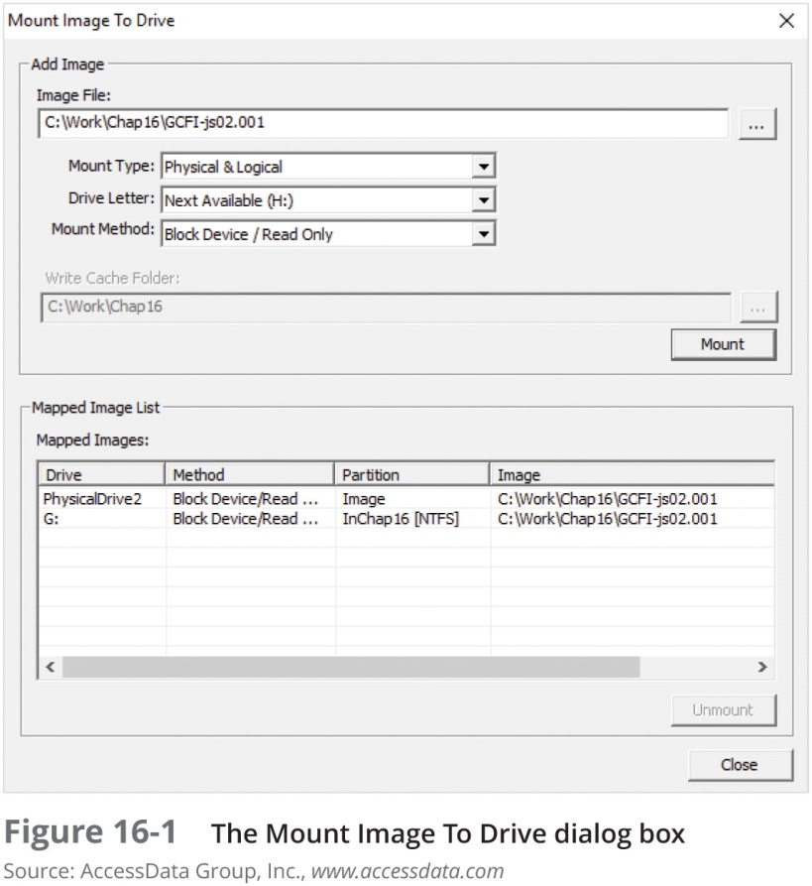
Performing a Cursory Exam of a Forensic Image

Slide 29
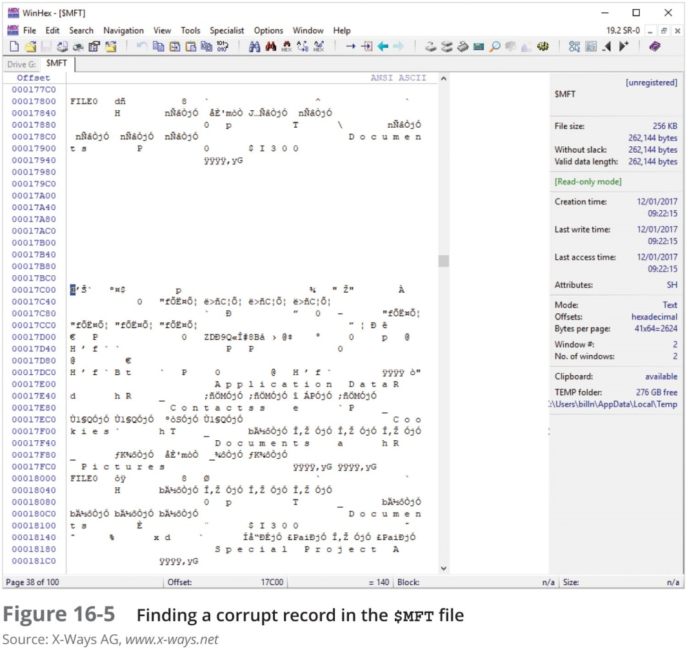
Performing a Detailed Exam of a Forensic Image

Slide 30
Performing the Exam
To maintain the highest possible ethical standards when conducting a forensics examination
You should develop a plan and review it before starting your analysis
Preparing for an Examination
Planning stage should cover all possibilities, including giving an opinion of whether data was corrupted intentionally or unintentionally

Slide 31
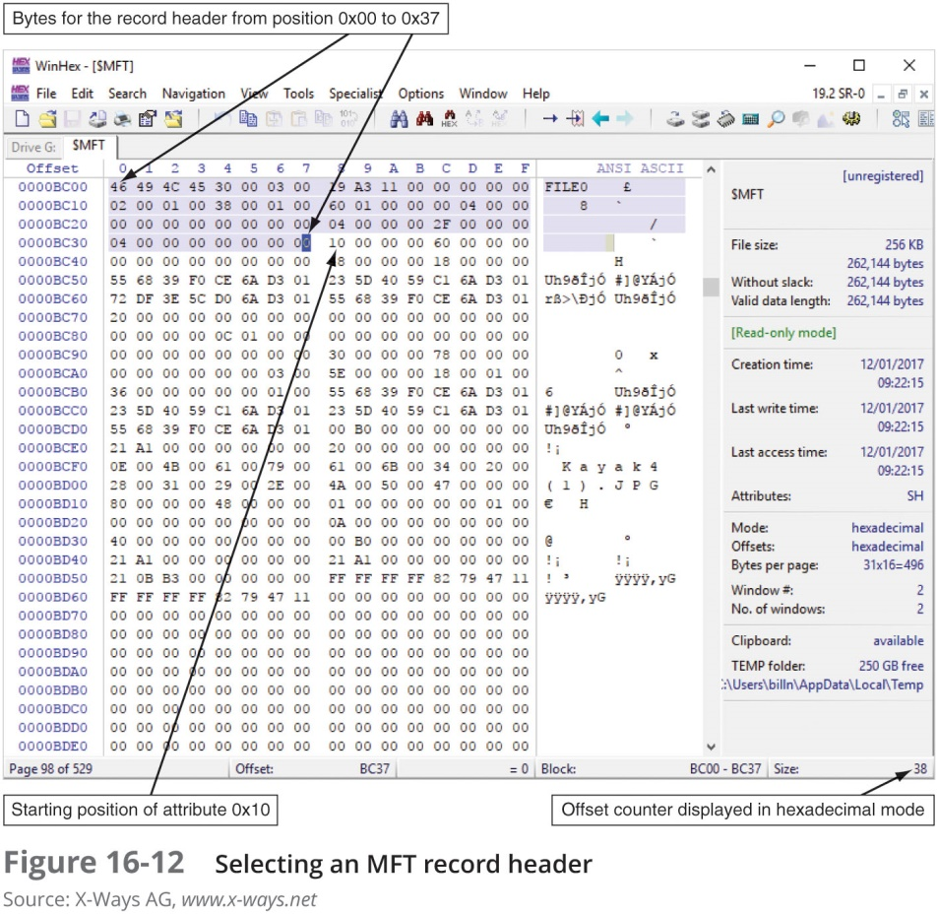
Interpreting Attribute 0x80 Data Runs

Slide 32
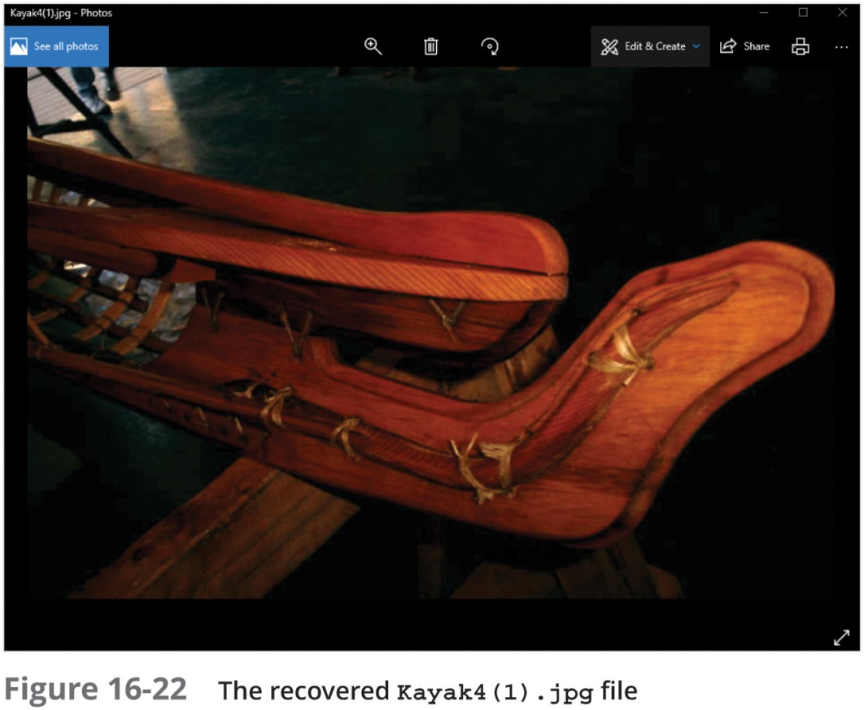
Carving Data Run Clusters Manually

Slide 33
Summary (1 of 3)
Ethics can be defined as rules you internalize and use to measure your performance
Digital forensics examiners don’t have the same formal codes of conduct that professions such as medicine and the law have
You owe your client a full understanding of the facts relevant to your opinion
Be aware of attempts to disqualify you as an expert
Courts use many factors in determining whether to disqualify an expert

Slide 34
Summary (2 of 3)
Be aware of obvious ethical errors, such as:
Ignoring contradictory data
Performing work beyond your expertise
Allowing attorneys to influence your opinion
Reaching a conclusion before completing research
No single source offers a definitive code of ethics for expert witnesses
The ISFCE Code of Ethics provides guidelines for its members and the IACIS has a guide for expected behavior of forensics examiners

Slide 35
Summary (3 of 3)
The inherent conflict between the needs of the justice system and your obligations for professional conduct can create ethical difficulties
The attorney who has retained you, opposing counsel, and the court owe you ethical responsibilities as an expert witness
The tools you use to recover, control, and track evidence are subject to review by opposing parties
After carving data artifacts, analyzing as much of the information as possible is critical

